Slide 1

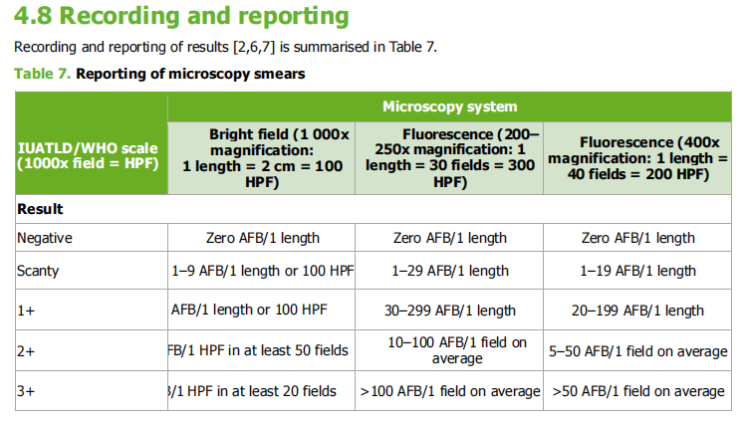

Slide 2
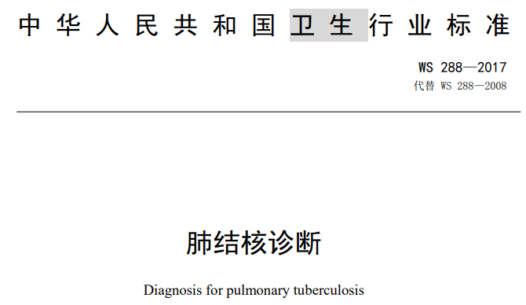
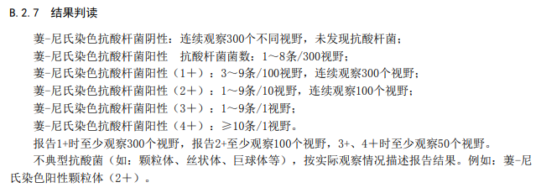
International scanty/rare corresponds approximately to very low positive smears in the Chinese grading system, spanning the Chinese “exact count” category and part of Chinese 1+; Chinese 2+, 3+, and 4+ roughly correspond to international 1+, 2+, and 3+, respectively.

